Slide 1
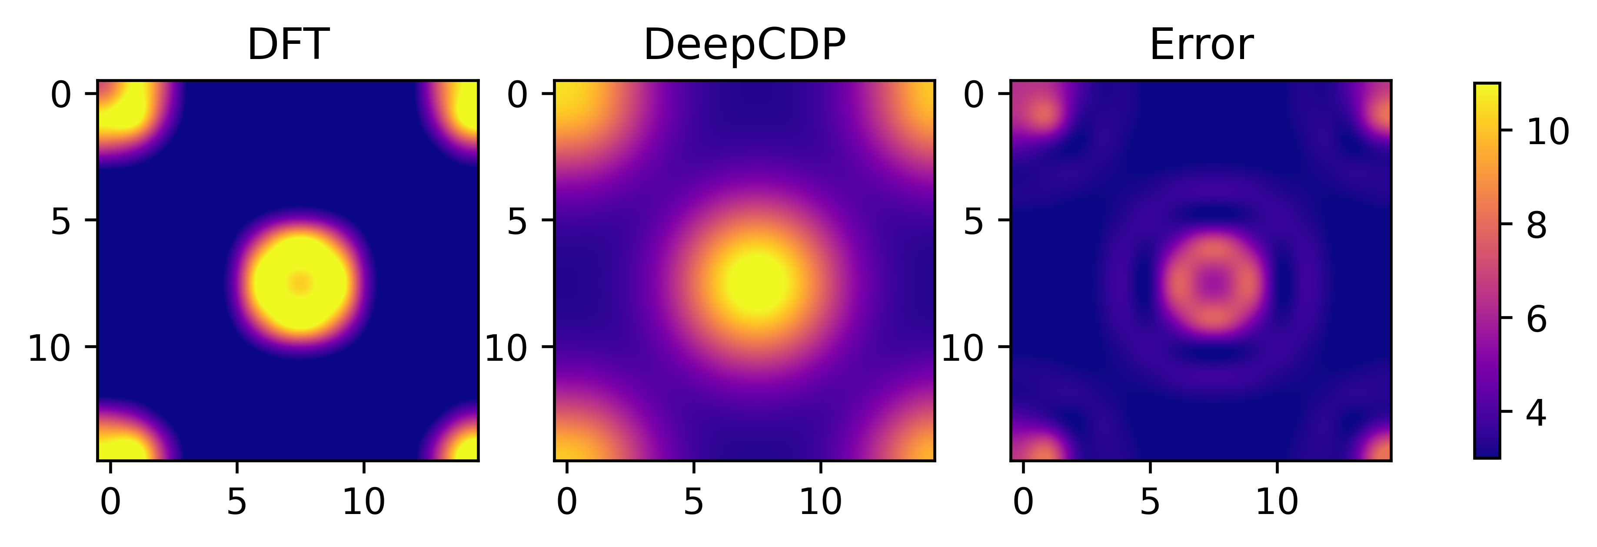
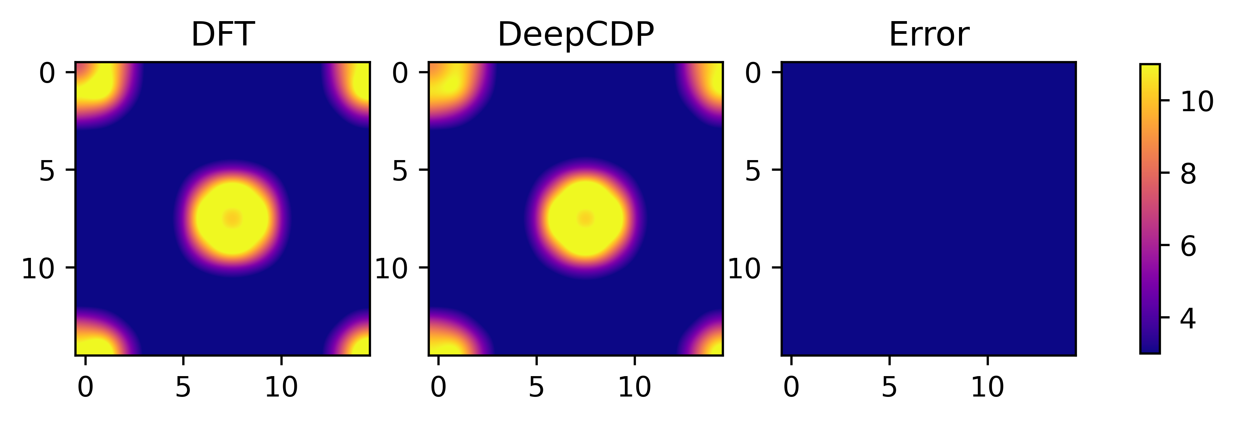
(a)
(b)

Slide 2
(a)
(b)
(c)

Slide 3
(a)
(b)

Slide 5
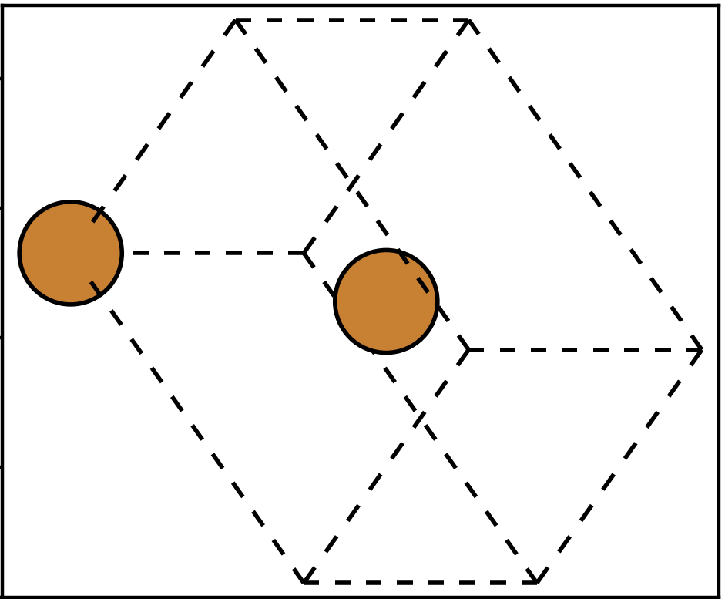
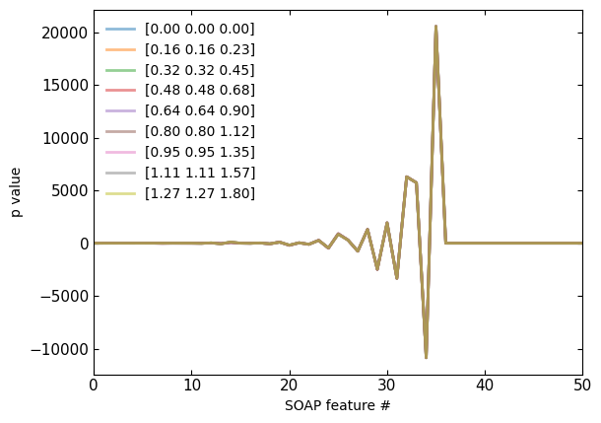
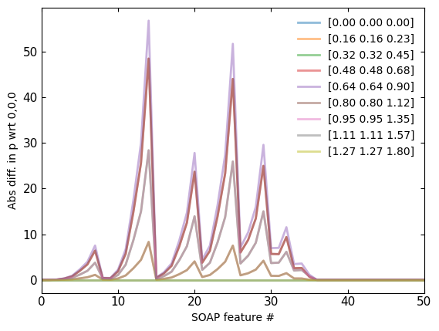
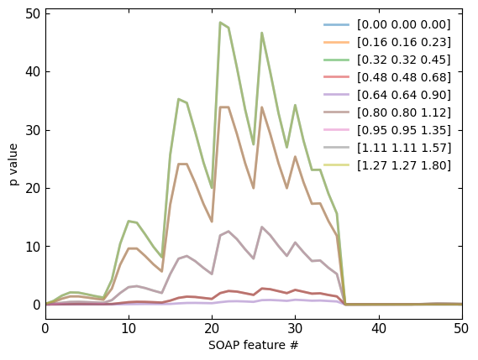
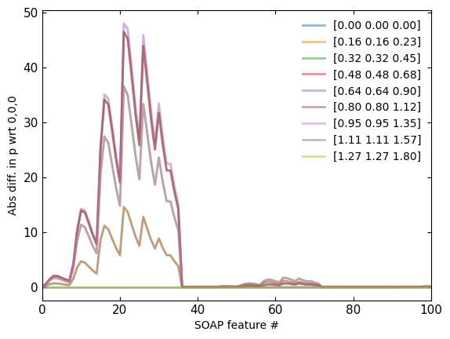
Non-weighted
Non-weighted
(b)
(c)
Weighted
Weighted
(d)
(e)
(a)

Slide 6
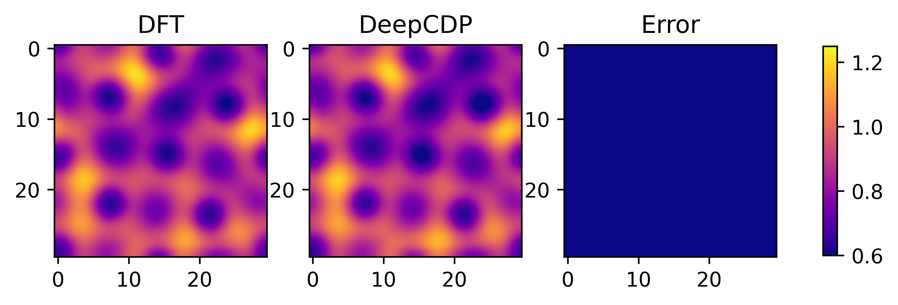
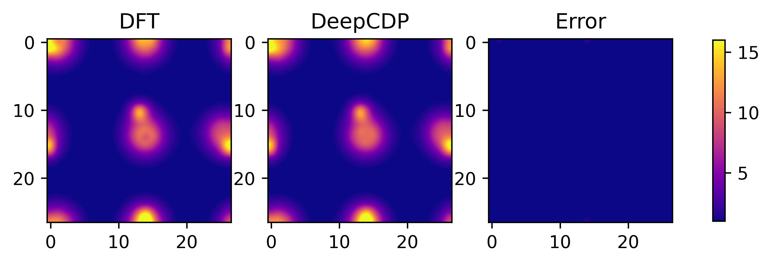
(a)
(b)

Slide 7
(d)
(e)

Slide 8
(a)
(b)
(c)

Slide 9
(a)
(b)
(c)

Slide 10
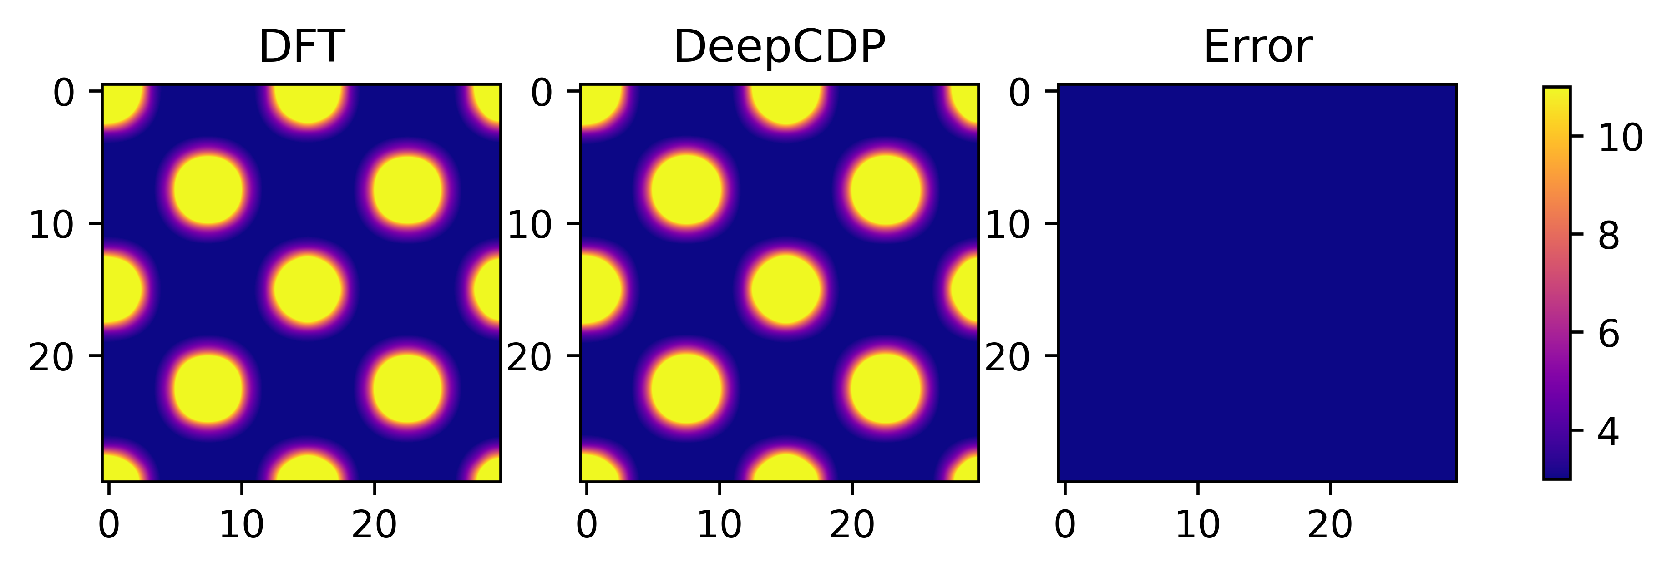
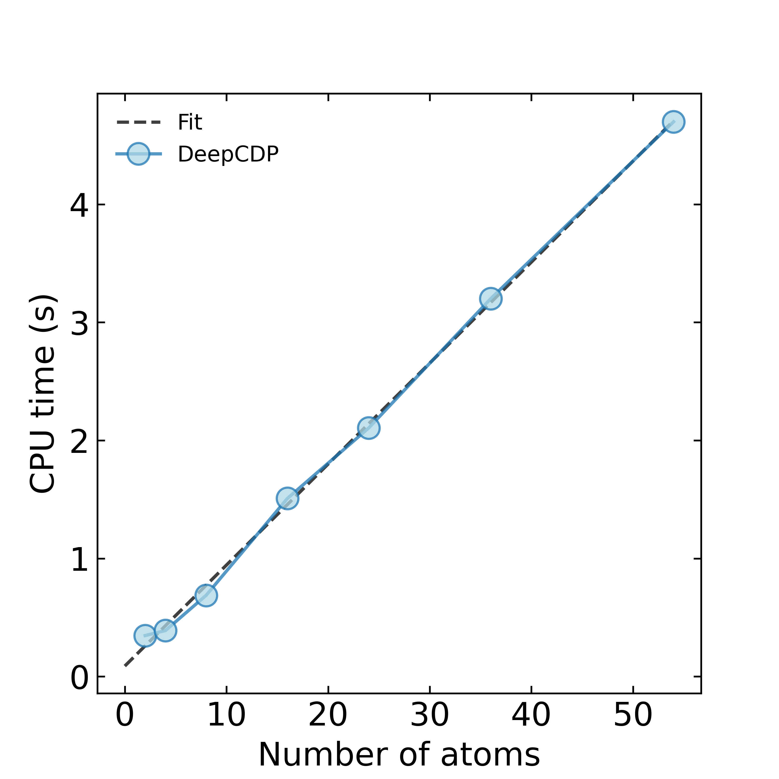
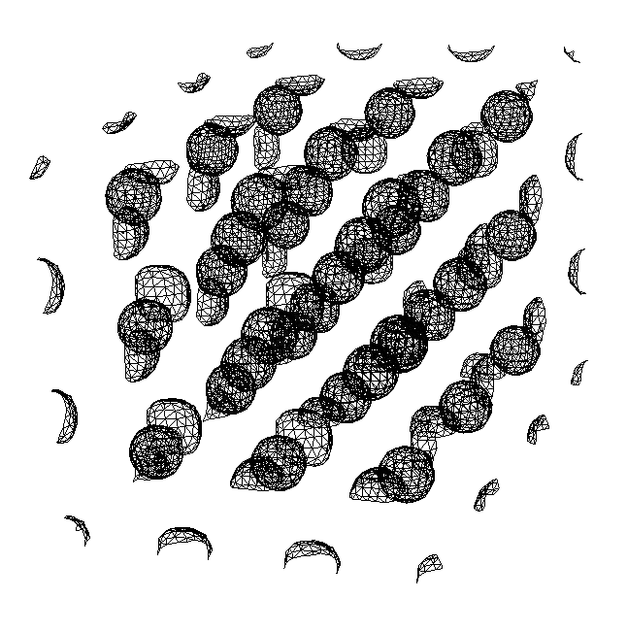
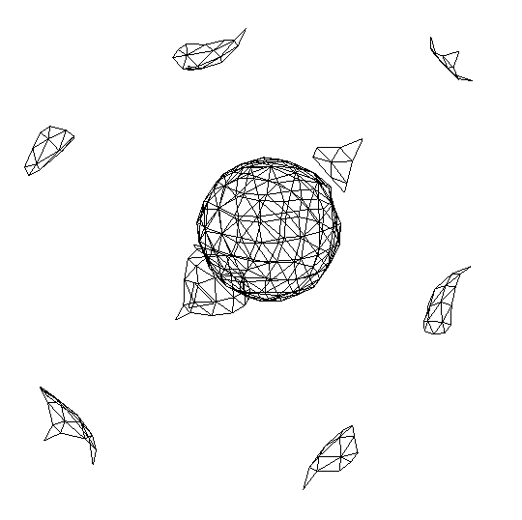
(a)
(b)
N = 54
N = 2
(N)

Slide 11
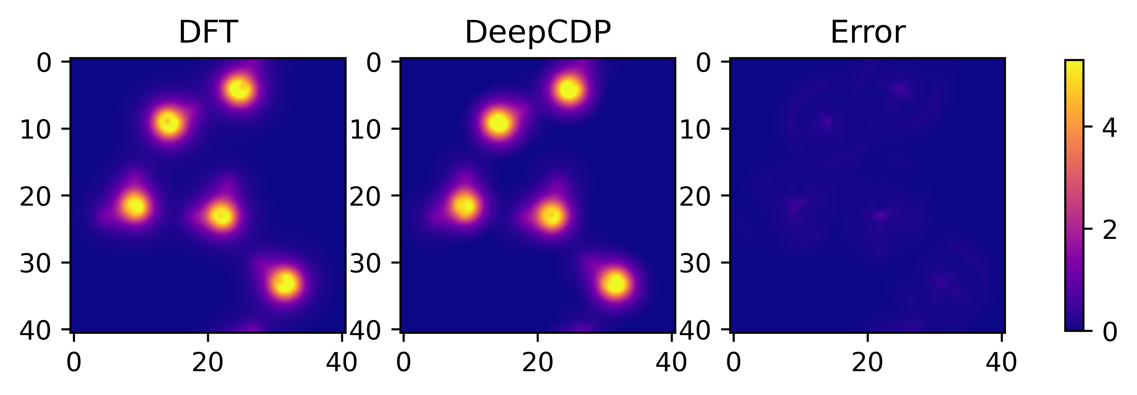
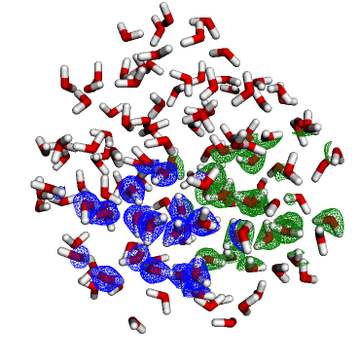
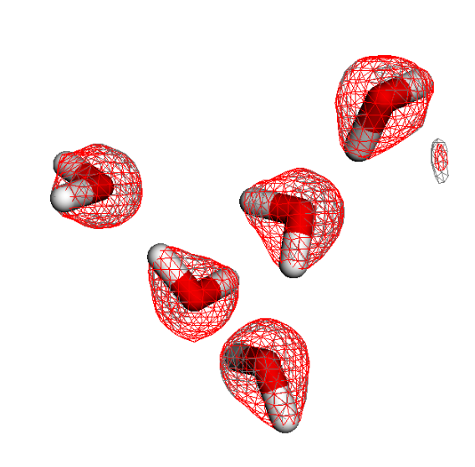
(a)
(b)
(c)

Slide 12
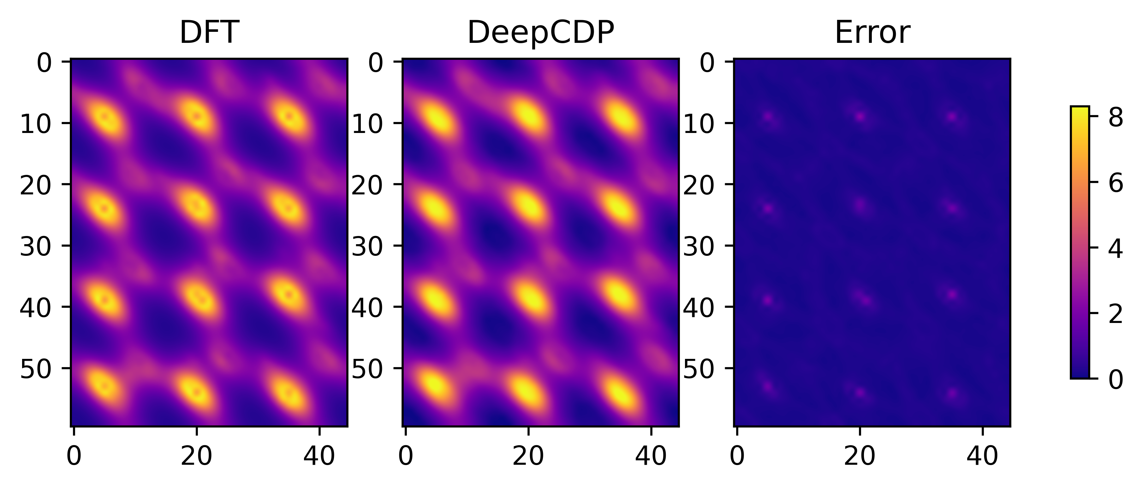
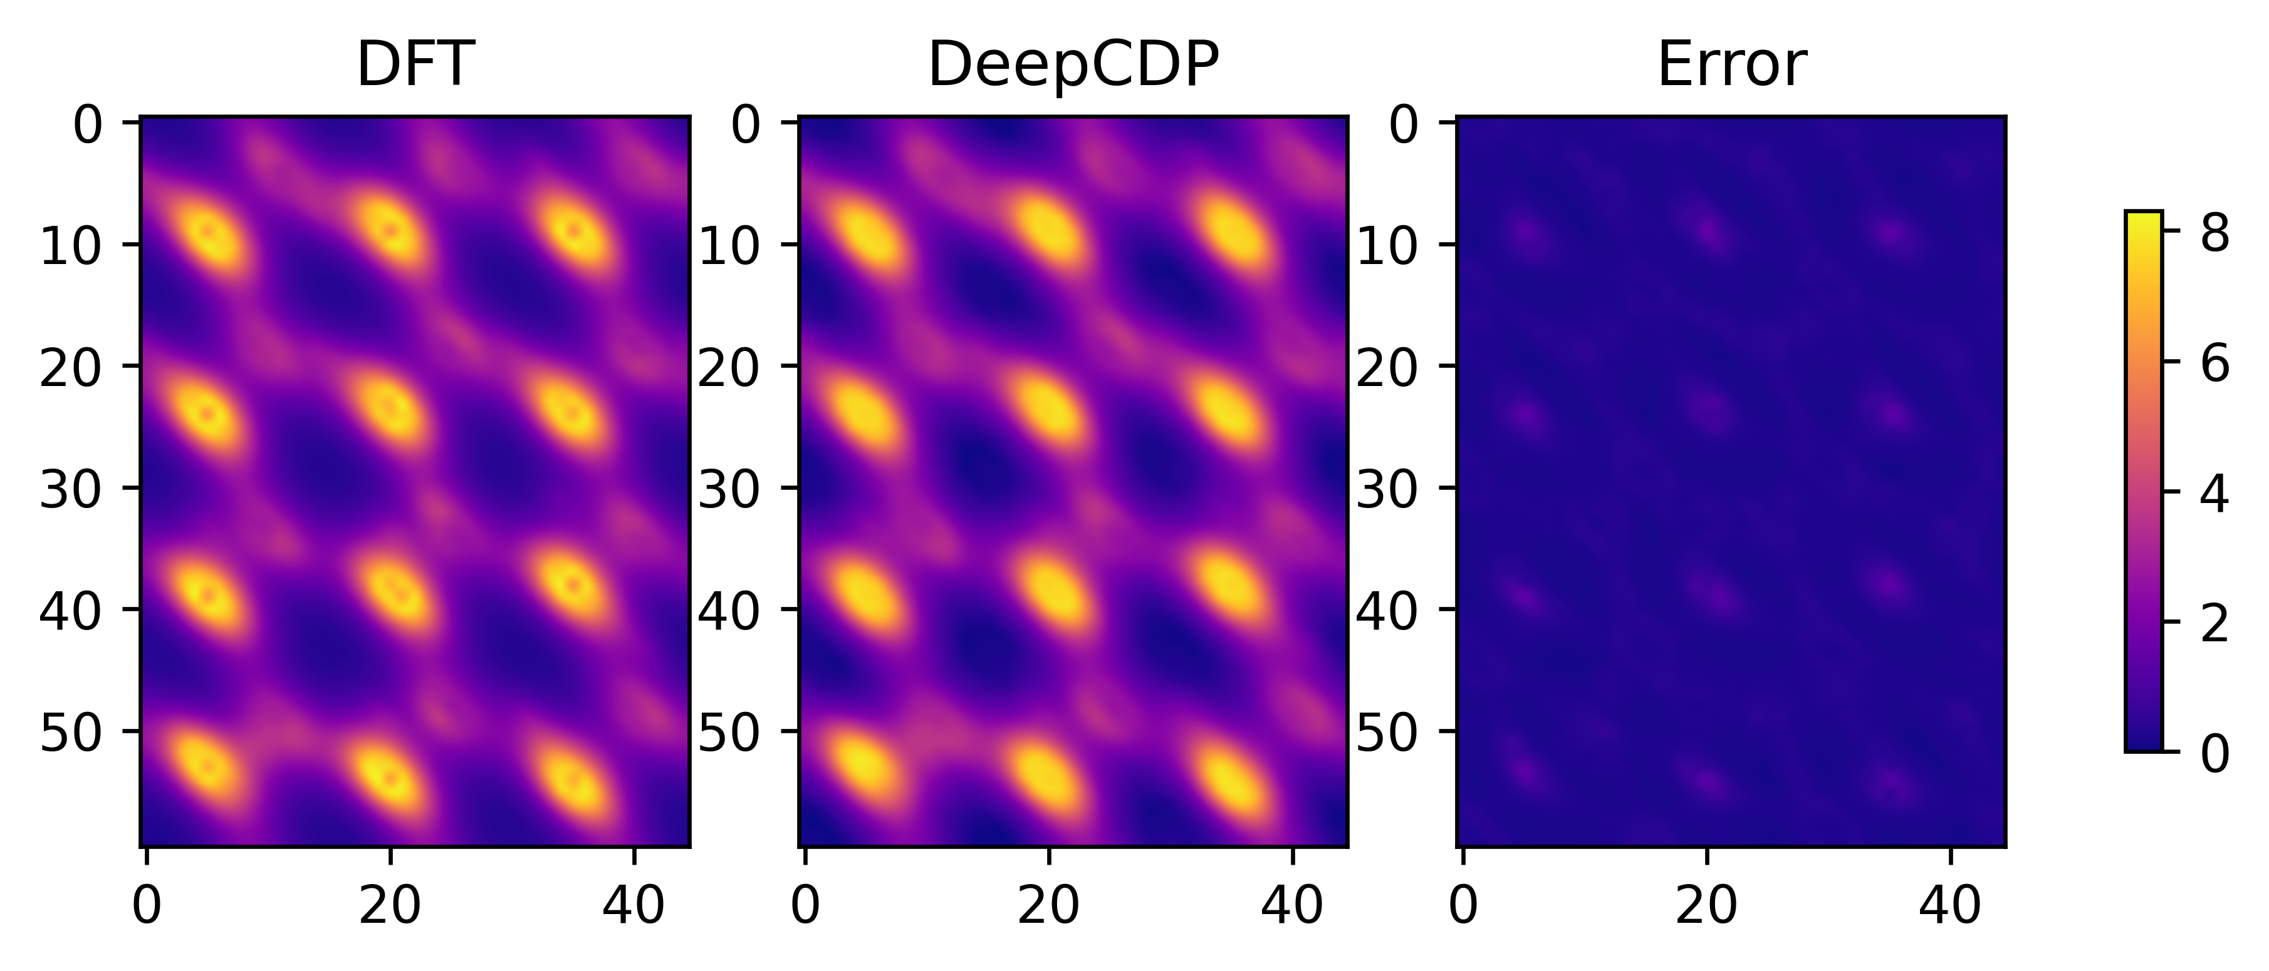
(a)
(b)
DeepCDP (u24C)
(c)
DeepCDP (c24C)

Slide 13
(a)
(b)
DeepCDP (u24C)
(c)
DeepCDP (c24C)

Slide 14
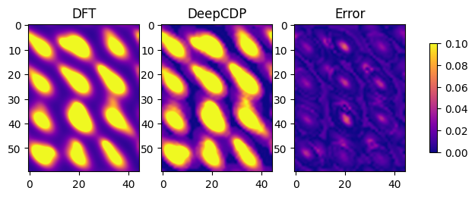


Slide 15
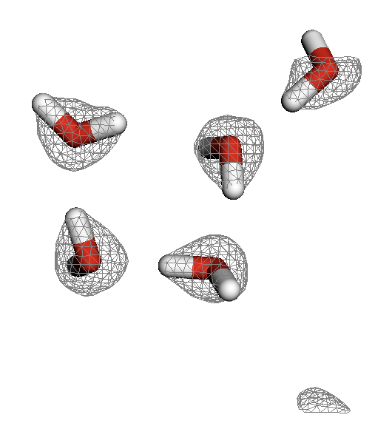
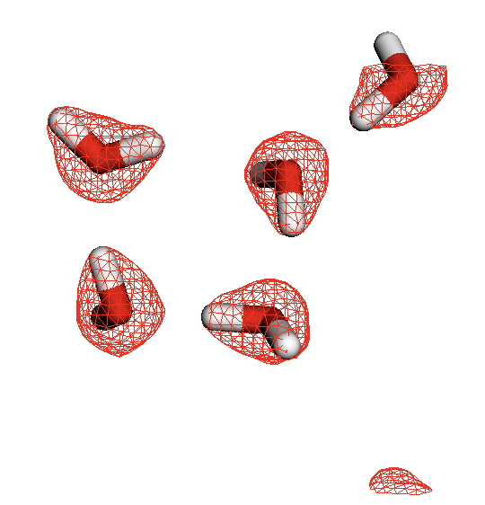
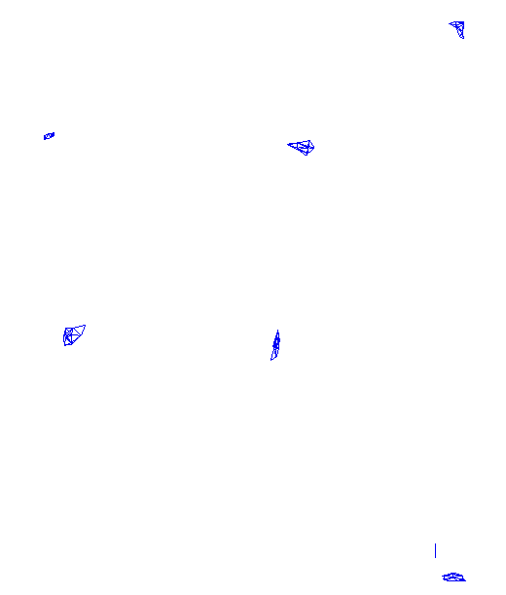
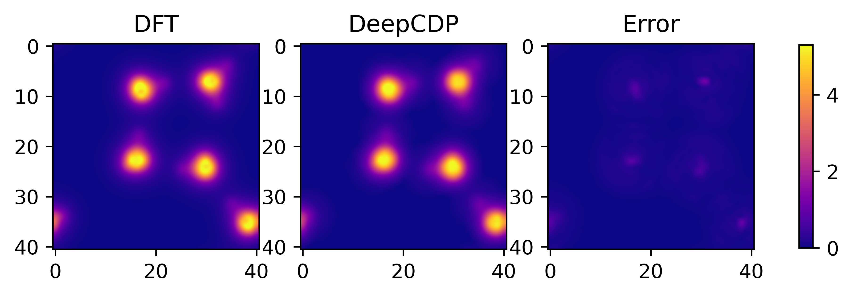
DFT
DeepCDP (c24C)
Error
DeepCDP (c24C)

Slide 16
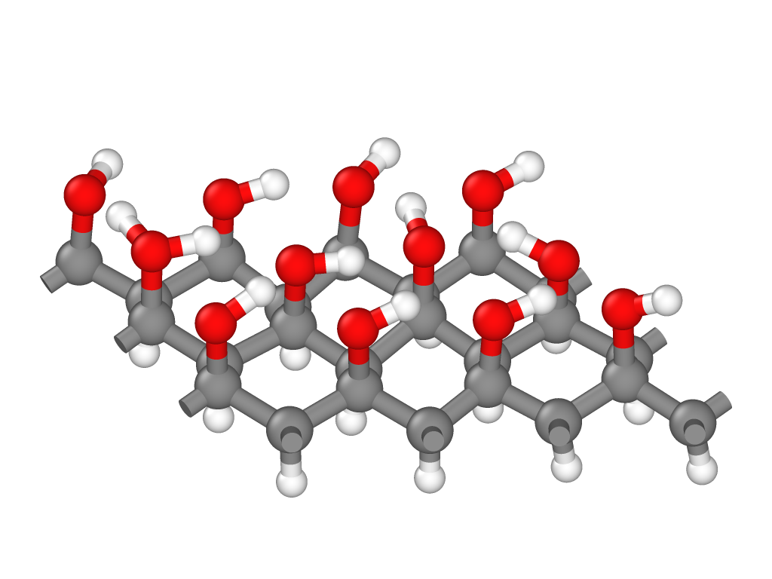





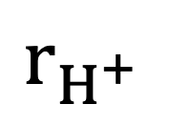








$$r_{H^{+}}$$
$$κ_{1}$$
$$κ_{3}$$
$$κ_{4}$$
$$κ_{2}$$
$$κ_{5}$$
$$κ_{8}$$
$$κ_{6}$$
$$κ_{9}$$
$$κ_{7}$$
$$κ_{10}$$
$$κ_{11}$$
$$κ_{12}$$
$$κ_{13}$$

Slide 17
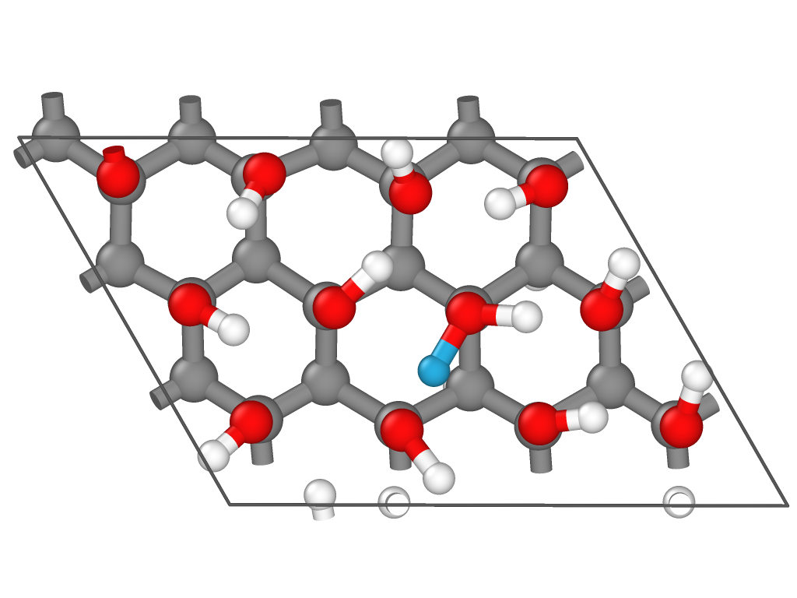
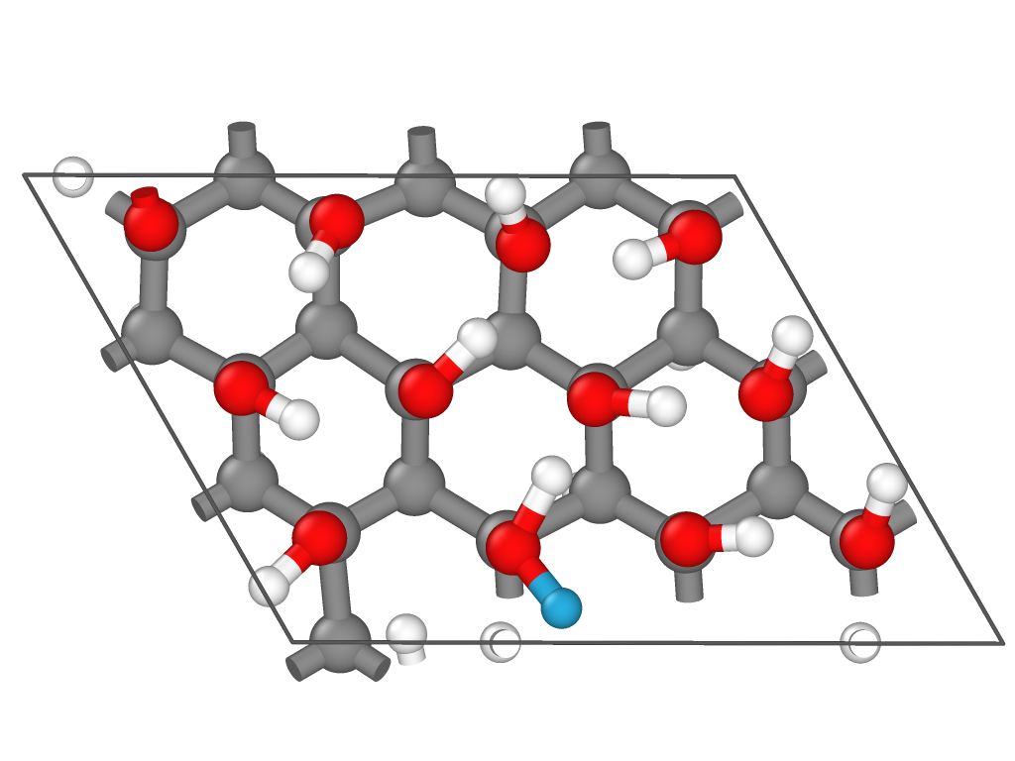
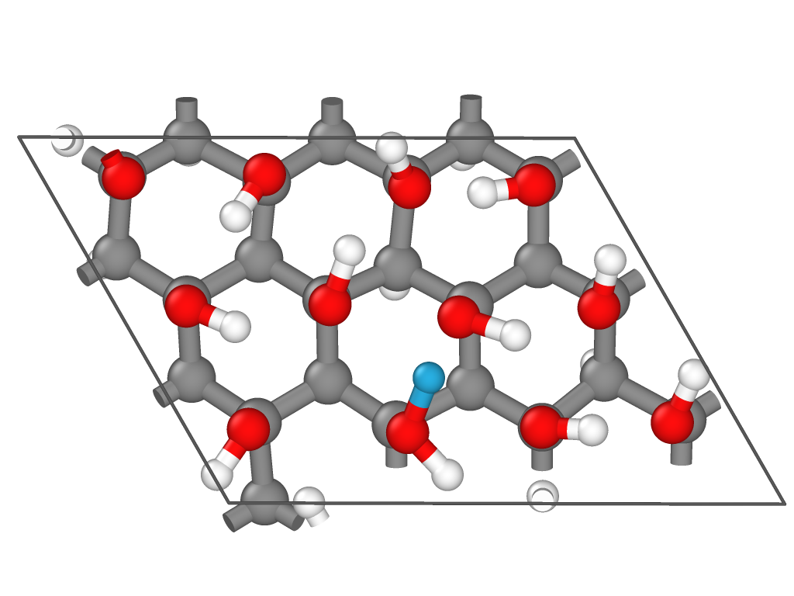
1
1
1
2
2
2
(a)
(b)
(c)

Slide 18
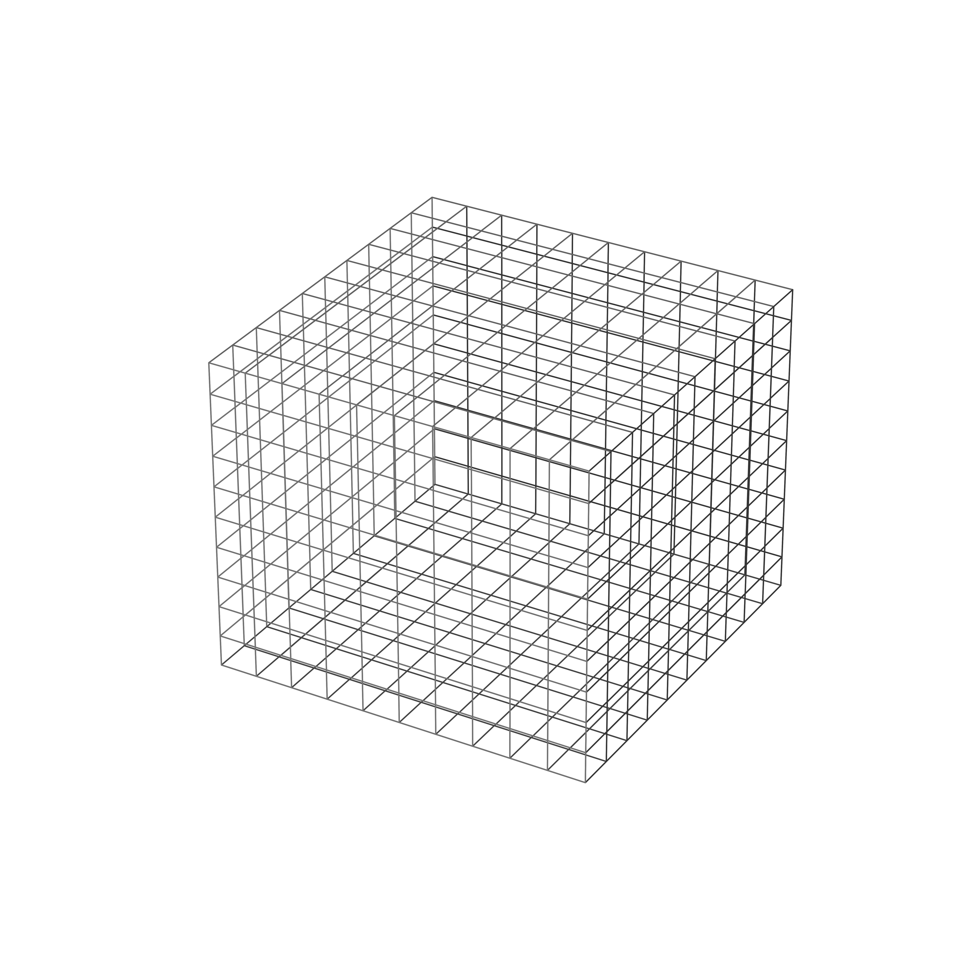
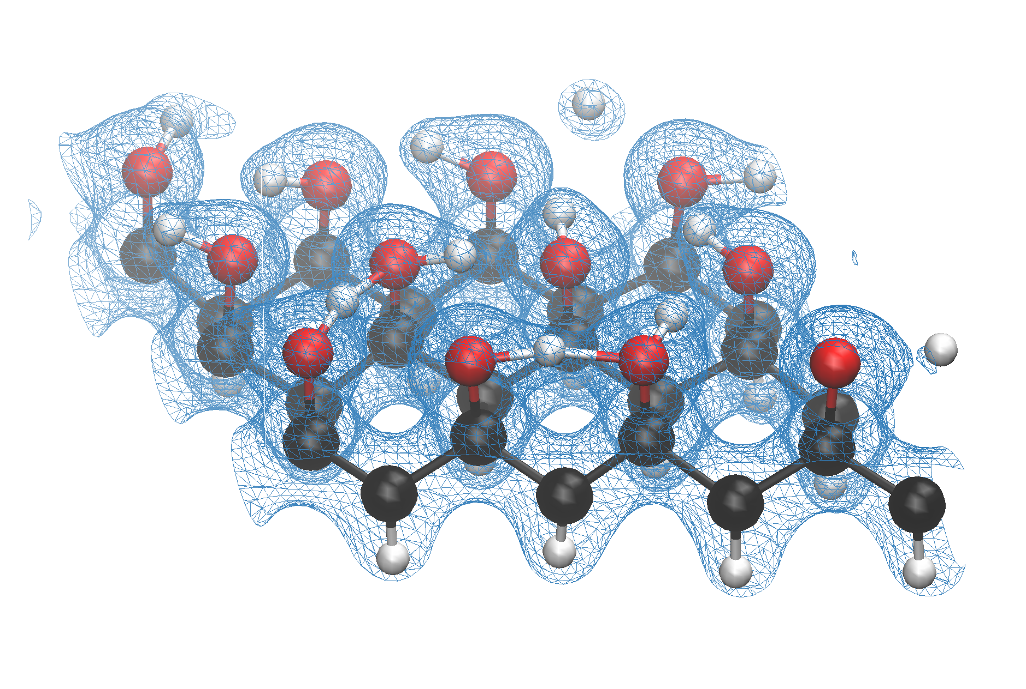

Slide 19
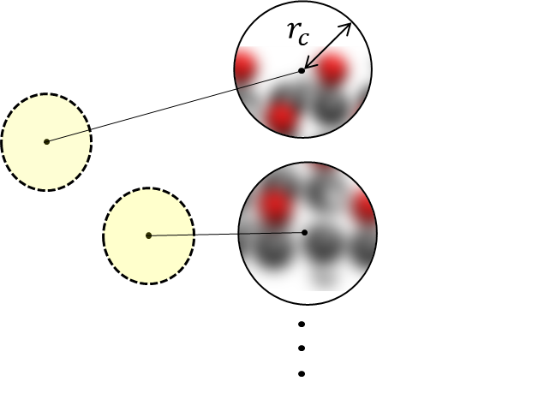
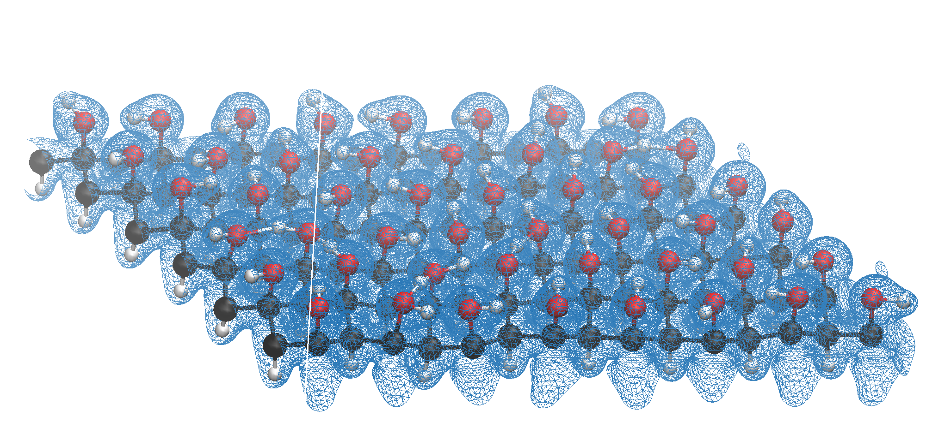
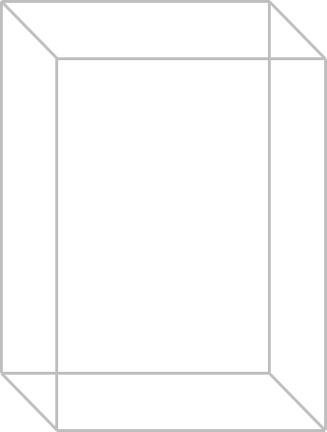
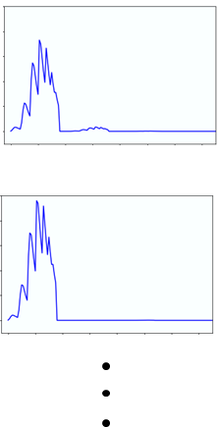
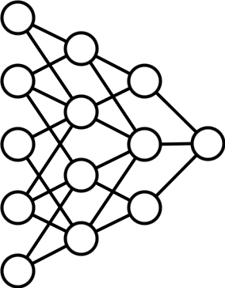
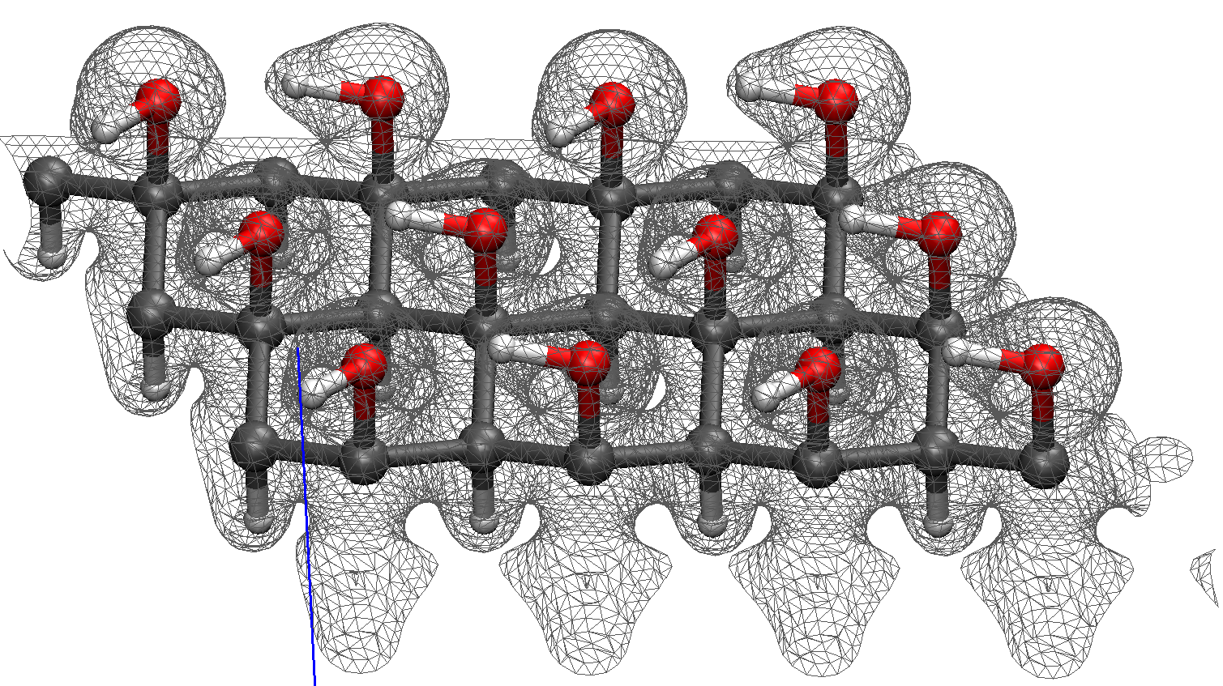
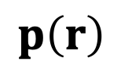
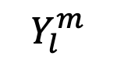
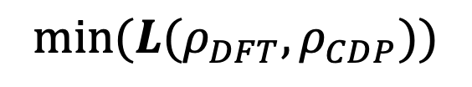
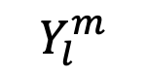
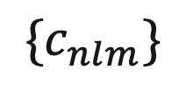
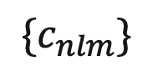
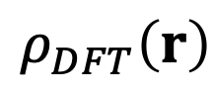
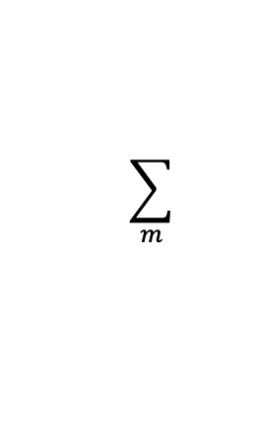
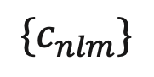
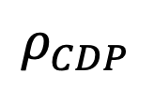
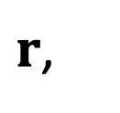
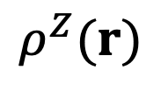
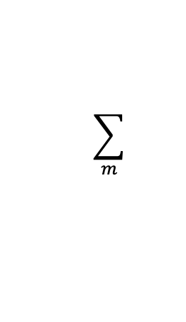
$$Y_{l}^{m}$$
$$\sum_{m}{ }$$
$${\{c}_{nlm}\}$$
$$Y_{l}^{m}$$
$$\sum_{m}{ }$$
$${\{c}_{nlm}\}$$
$r$,
$$ρ_{DFT}\left(r\right)$$
$$ρ^{Z}(r)$$
$${\{c}_{nlm}\}$$
$$p\left(r\right)$$
$$min(L(ρ_{DFT},ρ_{CDP}))$$
$$ρ_{CDP}$$
Atomic coordinates and electron density from DFT
Expansion coefficients from atomic densities and spherical harmonics
Power spectrum vectors
Fitting neural network by minimizing loss function
Electron density prediction on test configurations

